Slide 1
A Computational Workflow to Construct Regulatory Networks of Transcription Factors and Pathways Using scRNA-seq Data for Mathematical Modeling Guanming Wu, Patrick Flynn, Patrick Conley, Shannon McWeeney, Anupriya Agarwal and Evan Lind Oregon Health and Science University, Portland, OR
Notes:
Along this line, I’d like to introduce a new Python based workflow we developed last year to …

Slide 2
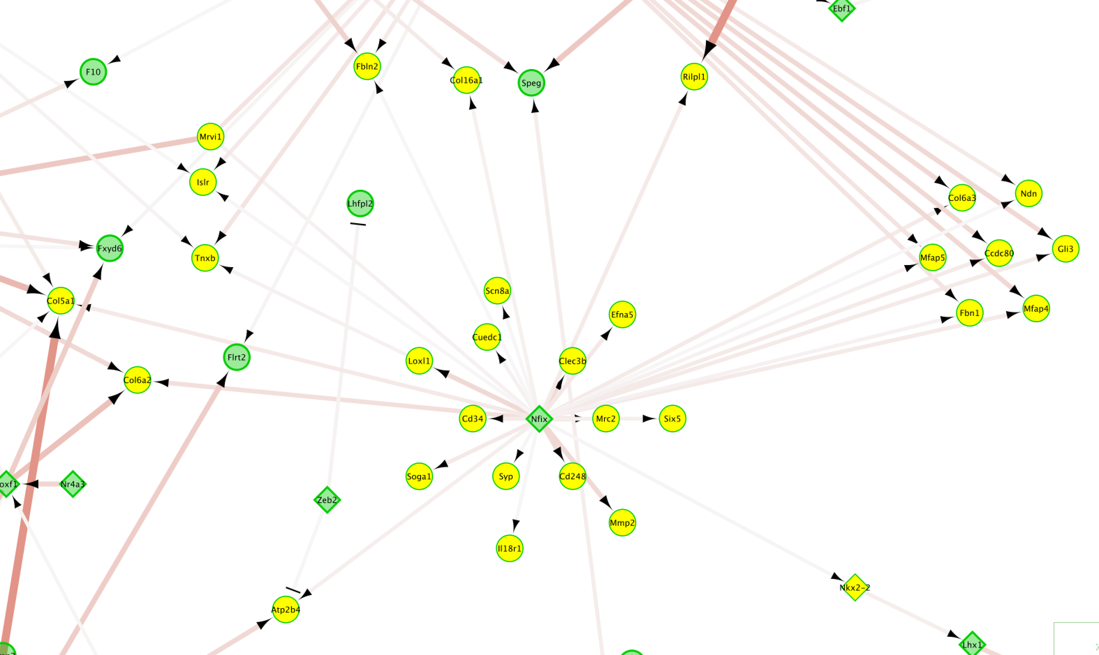
Common Gene Regulatory Networks
30 genes submitted to Reactome’s pathway enrichment analysis: https://reactome.org/reacfoam/?species=48887&color=COPPER&analysis=MjAyMzA2MTUwMDI4MDhfNDU0NA==&resource=TOTAL
Notes:
As shown in this network, gene regulator networks are usually gene-based composed of TFs and their targets. However, there is a limitation of this type of gene regulator network: We are not exactly sure what biological functions a TF is regulating using this network only. To better learn the function of a TF, such as NFIX, we may have to do a pathway gene set enrichment analysis for its targets, these 30 targeted genes. For example, we can submit these 30 genes to Reactome's pathway analysis web tool
30 genes selected as Nfix’s targets:
IRAG1
MMP2
NKX2-2
RILPL1
ATP2B4
SYP
CUEDC1
SIX5
ISLR
LOXL1
COL6A3
FBN1
TNXB
CCDC80
EFNA5
COL16A1
FBLN2
CLEC3B
MFAP4
MFAP5
COL6A2
CD248
MRC2
CD34
SCN8A
GLI3
NDN
SOGA1
IL18R1
COL5A1

Slide 3
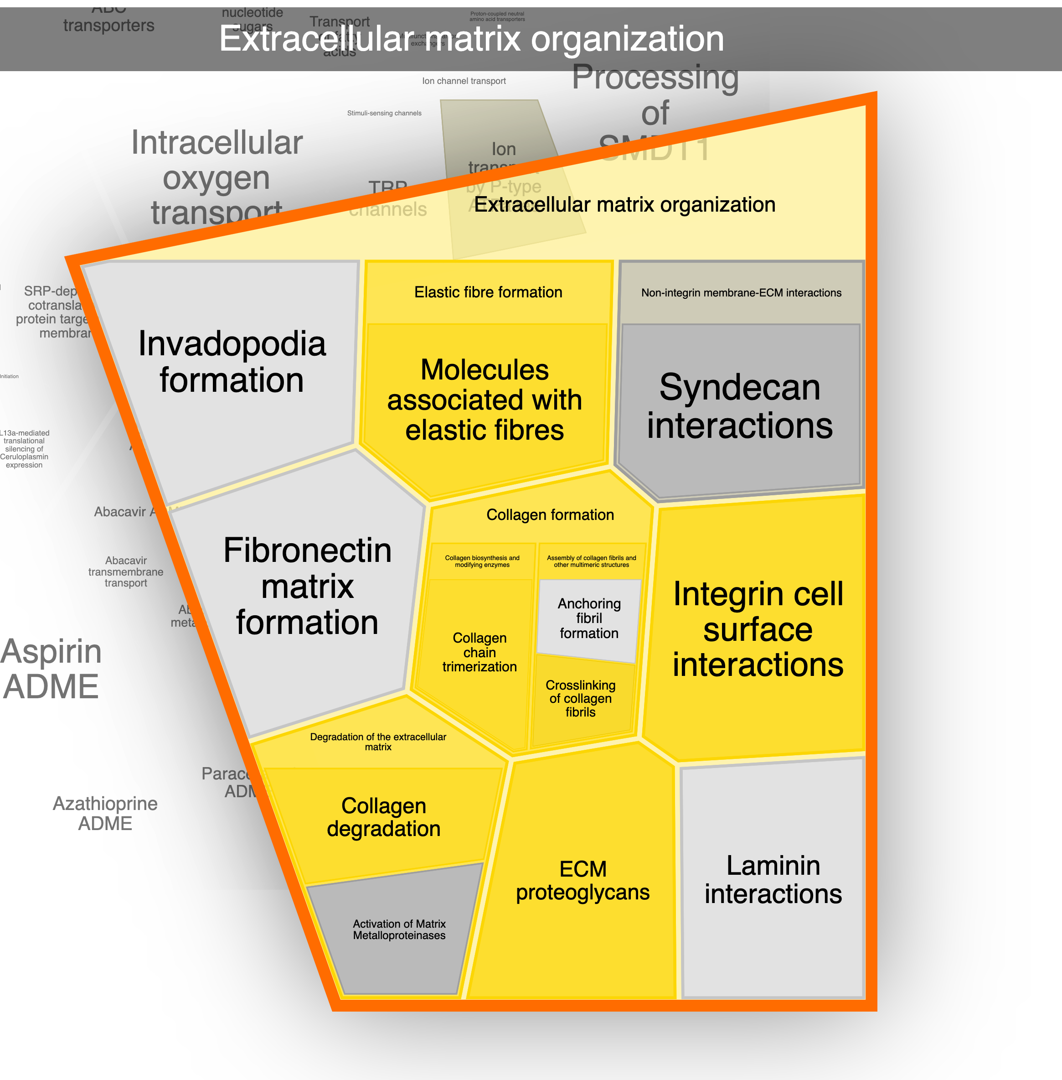
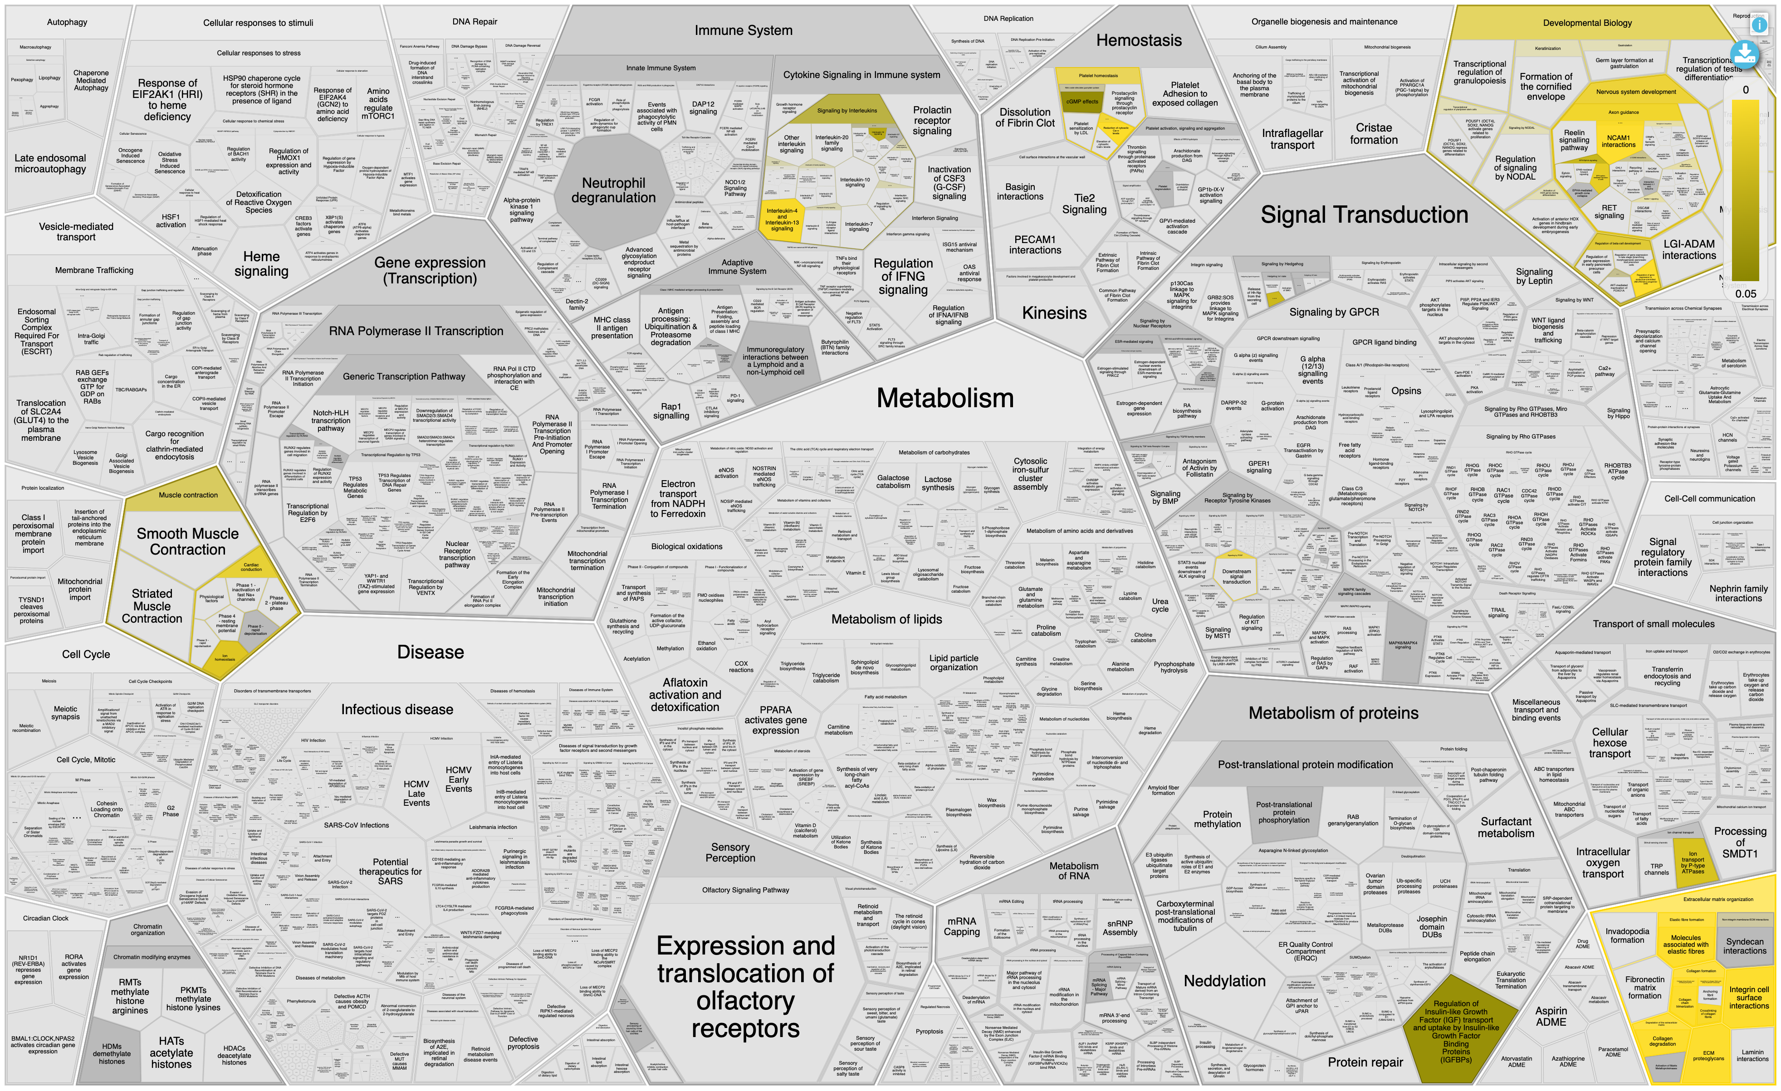
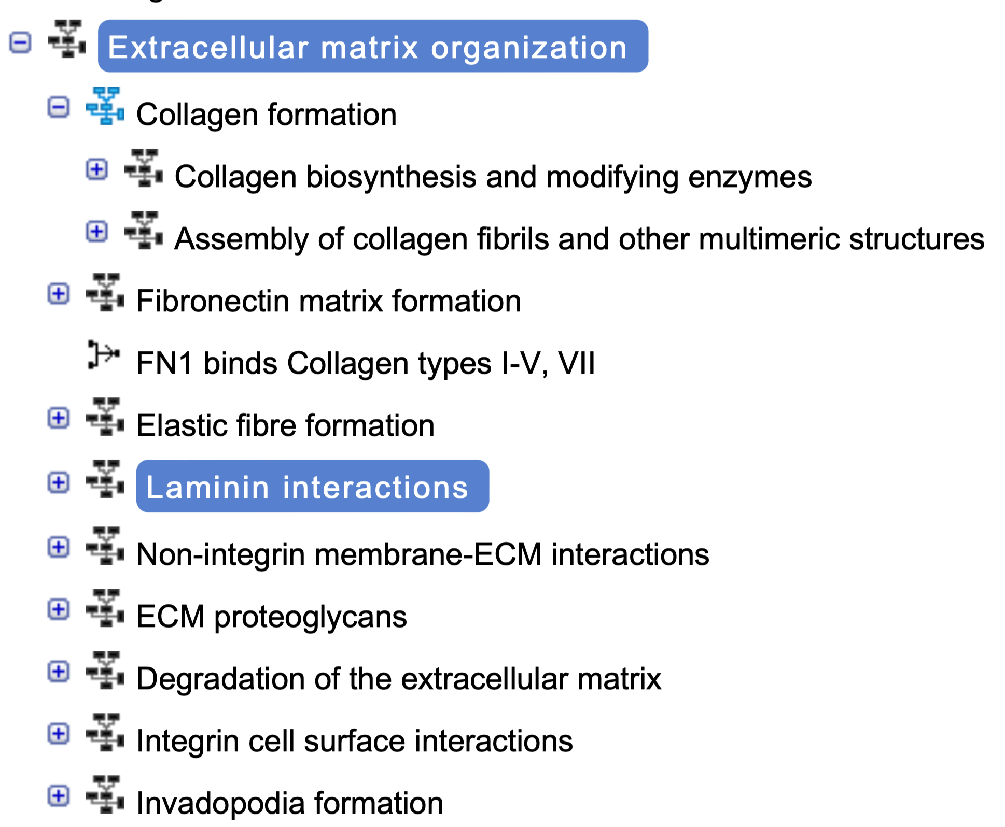
Pathway Enrichment Analysis
FDR: 2.66E-15
FDR: 4.83E-8
FDR: > 0.05
Notes:
Let's zoom into extracelluar matrix organization. As you can see here: The top level pathway, contains multiple sub-pathways, for example, Elastic fiber formation. Elase fiber formation contains a sub-sub-pathway called,.
Look at FDR values for three pathways: the highest level has lowest fdr, indicating the strongest signal, one of sub-pathways 'Integrin cell.." and another pathway "Laminnin interactions" is not significant with FDR > 0.05. This example shows a higher level pathway may have stronger signal than lower level pathways. This example showed that in order to have a better visualization, we may have to put higher and lower levels of pathways together in a view and then link these pathways somehow.

Slide 4
New Approach: TFs and Pathways in the Same Network
Provides functional interpretation directly to TFs
Keeps the pathway hierarchical relationships
Notes:
To address these two requirements: first provide… and second keep … we developed a new analysis approach by collaborating with two wet lab groups at OHSU.

Slide 5
New Workflow
Pre-process and batch removal
Clustering and
UMAP
Activity inference
via AUCell
Cluster selection
Pre-Processed Data
Cell clusters and types
Pathway and TF Activities
Focused Cluster
TF targets and pathway genes overlapping analysis
Differential activity analysis
TF correlation and target analysis
Correlation analysis via GLM
TFs ->| TFs
TFs ->| Pathways
Pathways vs. TFs
Significant Pathways and TFs
Reactome annotation
Merge all edges and visualize in Cytoscape
Reactome annotation
Pathways -> TFs
Pathways -> Pathways
Regulatory Network
Convert
Boolean Network
Simulate in ReactomeFIViz
Reactome pathway knowledgebase: https://reactome.org
ReactomeFiViz: https://reactome.org/tools/reactome-fiviz
DoRothEA regulon data: https://saezlab.github.io/dorothea/
AUCell: https://github.com/aertslab/pySCENIC
Notes:
The analysis workflow is composed of multiple steps and works like this: first ...

Slide 6
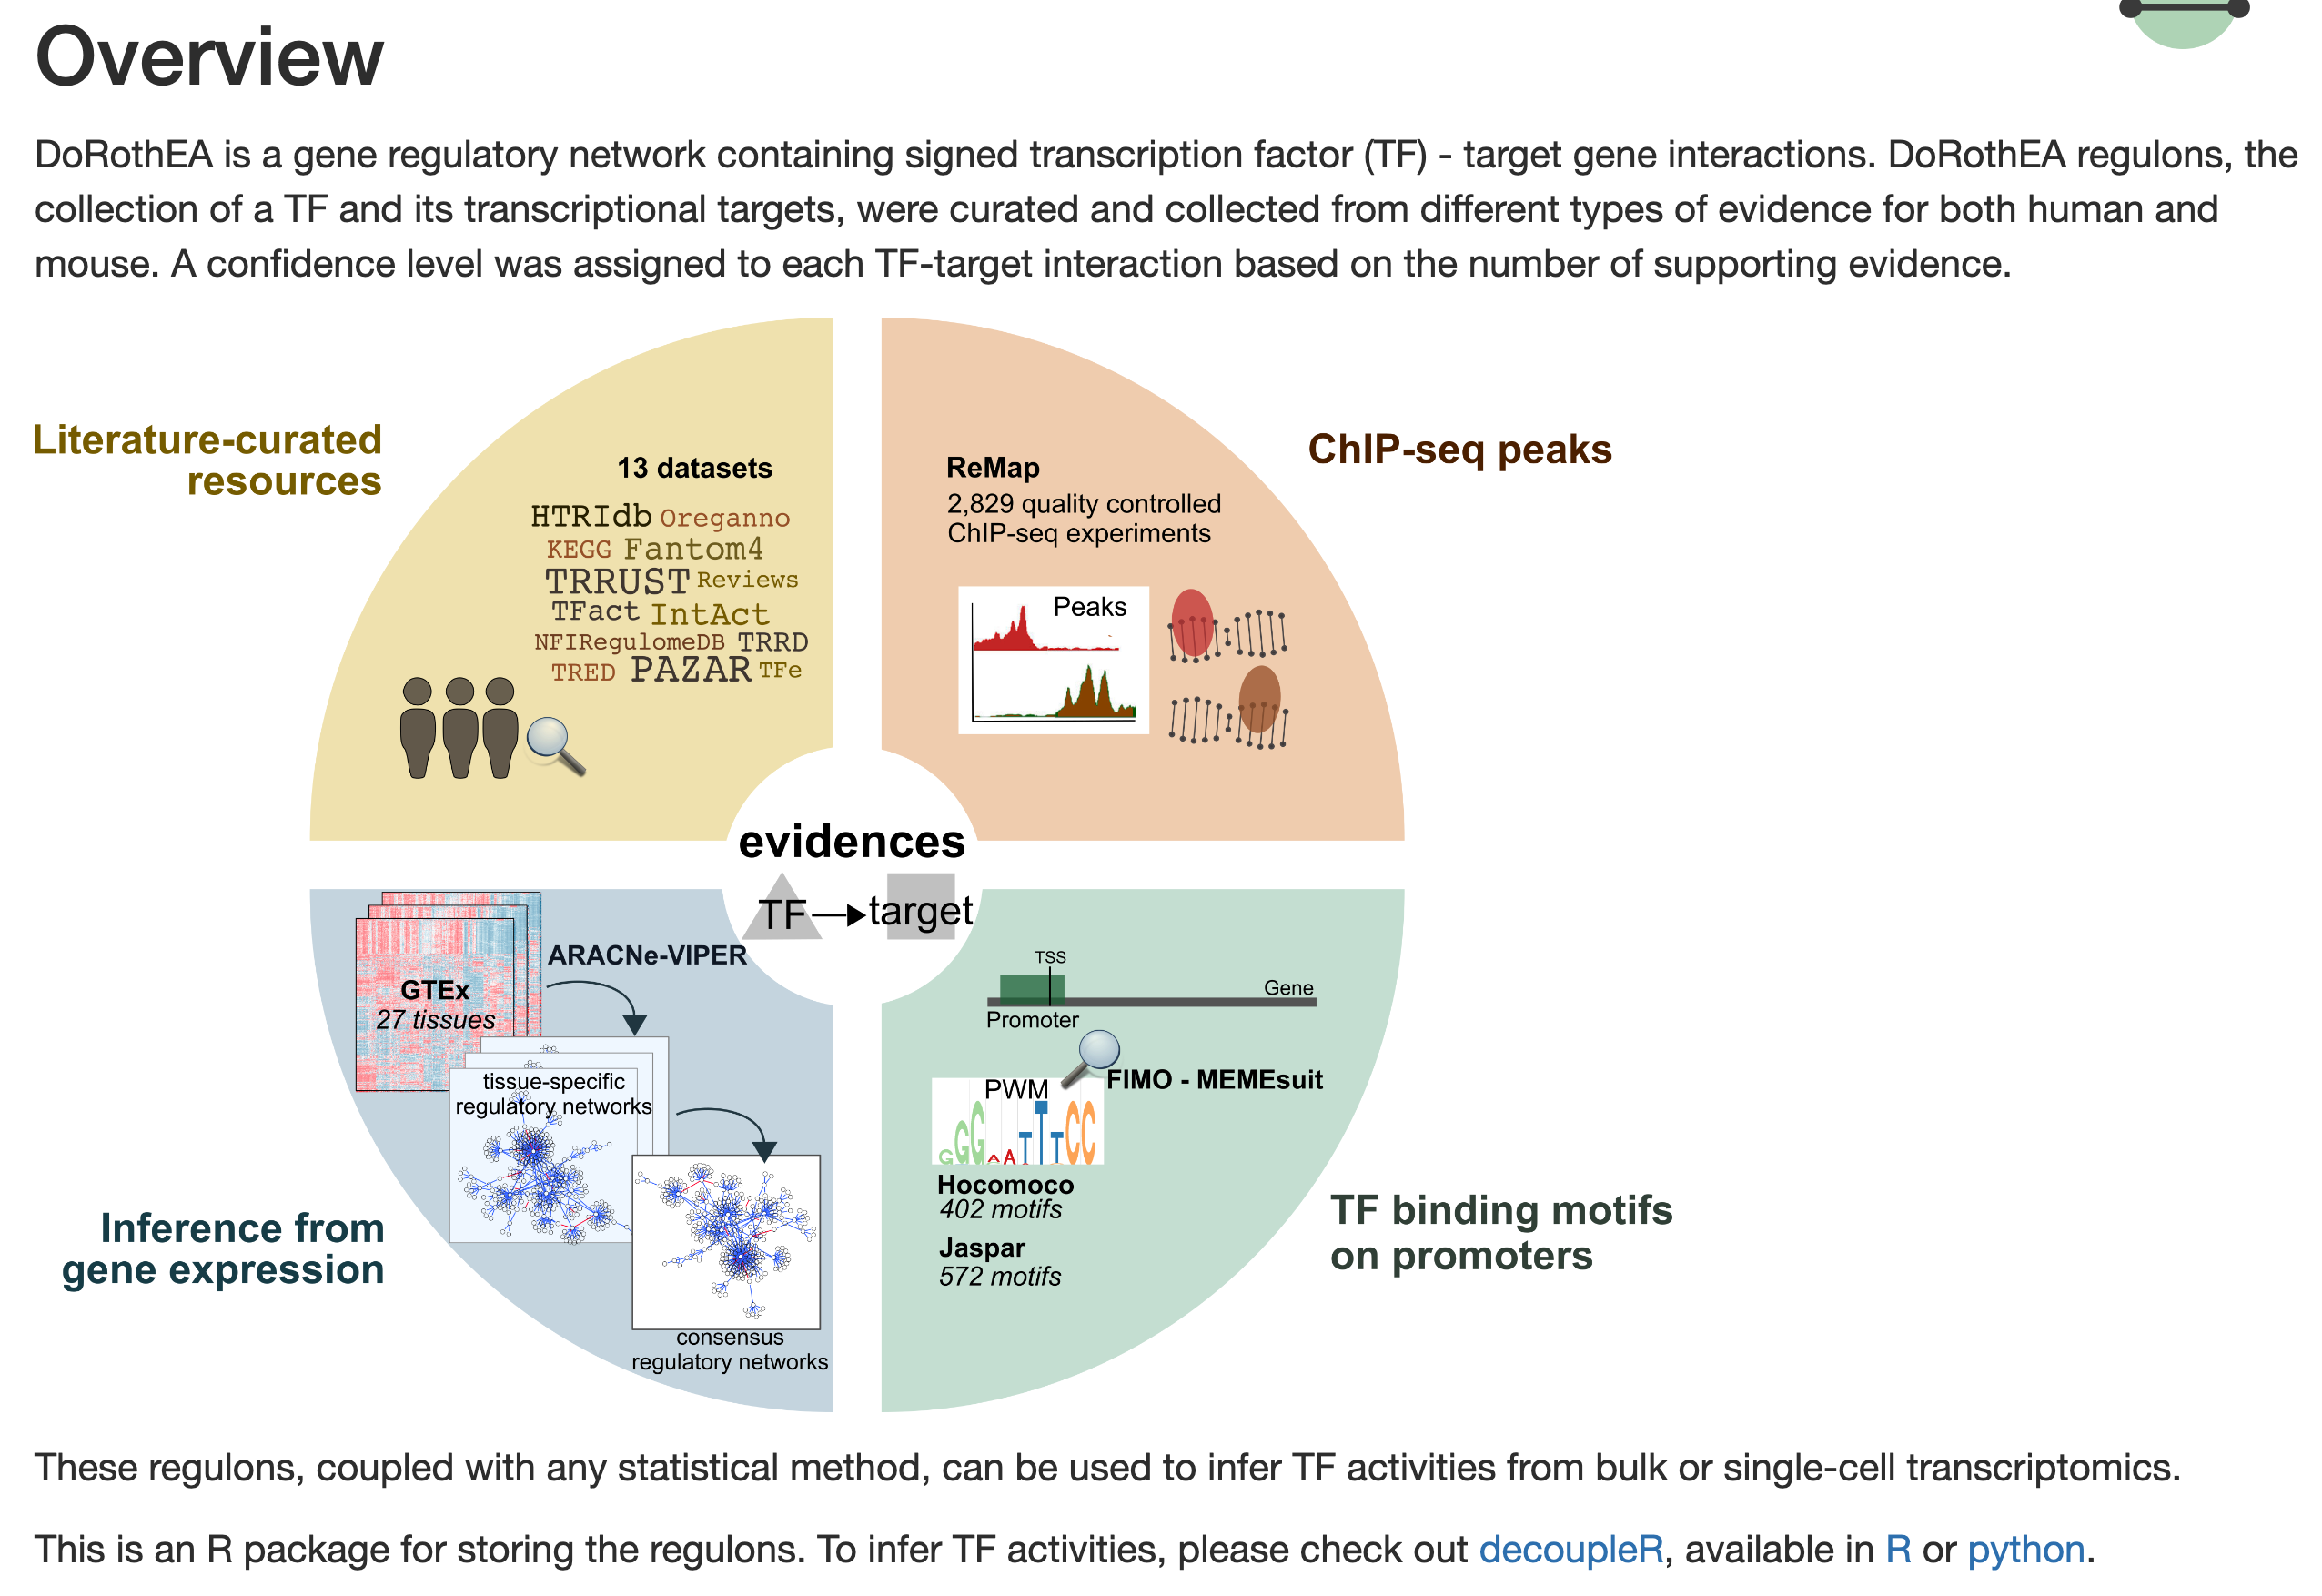
DoRothEA: Collection of Human and Mouse Regulons
https://saezlab.github.io/dorothea/
Notes:
In this analysis workflow, we have not included scATAT-seq data yet and will try to integrate them in the future. For the time being, we are using this regulon dataset called DoRothEA produced by Julio Saez-Rodruguez’s lab in Heidelberg University. This dataset was collected from multiple different data sources, including... So they have divided evidence for tf/target interactions into 5 categories, from A -> E with A the most reliable, and E the least reliable.

Slide 7
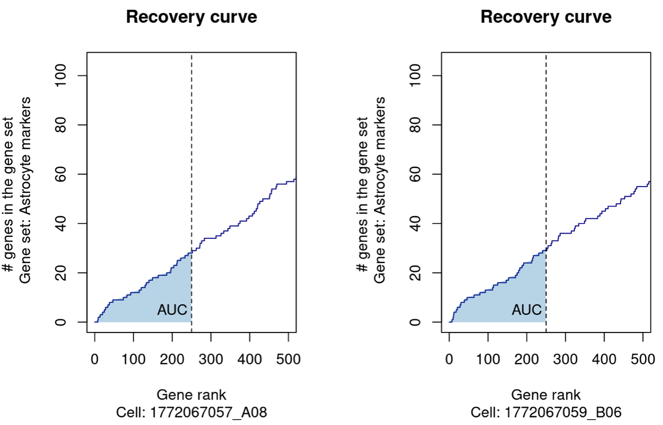
AUCell for Activity Analysis
Stepwise plot
Number of genes in a gene set fallen into top 5% of genes subject to analysis
https://bioconductor.org/packages/release/bioc/vignettes/AUCell/inst/doc/AUCell.html
Notes:
The algorithm we used to infer pathway and TF activity is called AUCell. As you can see here, basically AUCell tries to calculate this so-called Area under curve from this recovery curve based on gene rank according to their expression values in individual cells. In the actual calculation, only top 5% of genes subject to analysis to reduce the effect of the noise at the bottom of the ranking since many genes might be tied at 0 counts. Here are two examples,
https://bioconductor.org/packages/release/bioc/vignettes/AUCell/inst/doc/AUCell.html: In order to calculate the AUC, by default only the top 5% of the genes in the ranking are used (i.e. checks whether the genes in the gene-set or signature are within the top 5%). This allows faster execution on bigger datasets, and reduce the effect of the noise at the bottom of the ranking (e.g. where many genes might be tied at 0 counts).
Total: 5,000 genes, total 5% is 250 genes.

Slide 8
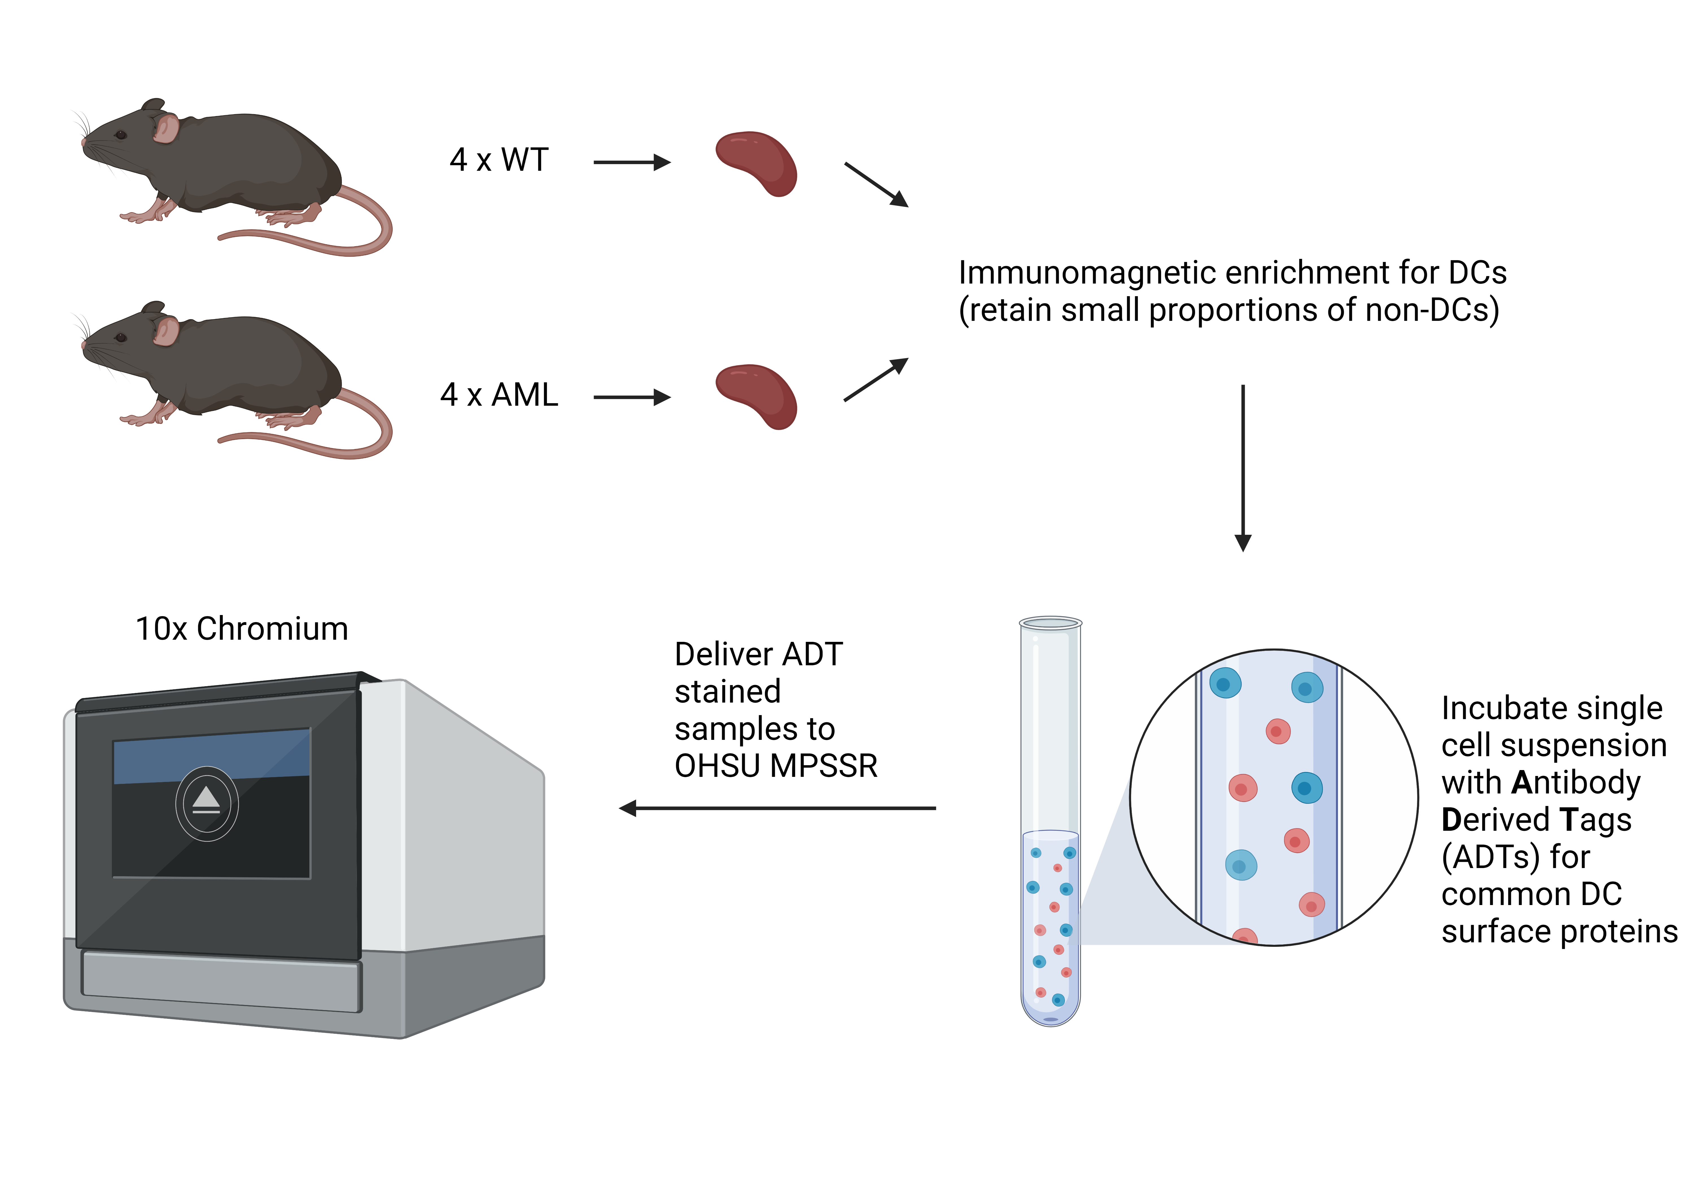
scRNA-seq Data
C57BL/6 Healthy Mice
C57BL/6 Leukemia Mice:
LysM_Cre+/-, TET fl/fl, TP53 fl/fl, FLT3-ITD +/-
Patrick Flynn & Evan Lind
Notes:
We applied this workflow to a scRAN-seq data collected from 4 WT mice, and 4 AML mice, enriched for dendritic cells from mouse spleen.
Sample processing: Whole mouse spleens were harvested and processed into single cell suspensions after RBC lysis. Immunomagnetic enrichment for dendritic cells (but still retaining small proportions of non-DCs). Cells were counted and then incubated with BioLegend Total Seq-A ADTs for surface protein detection. After ADT incubation, stained samples were transferred to OHSU MPSSR for library preparation and sequencing.

Slide 9
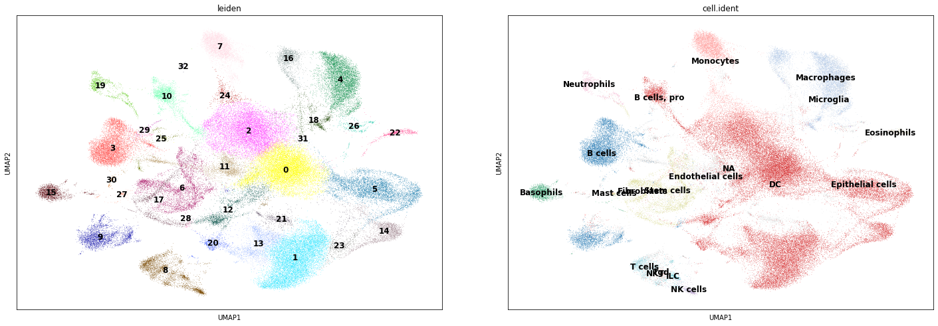
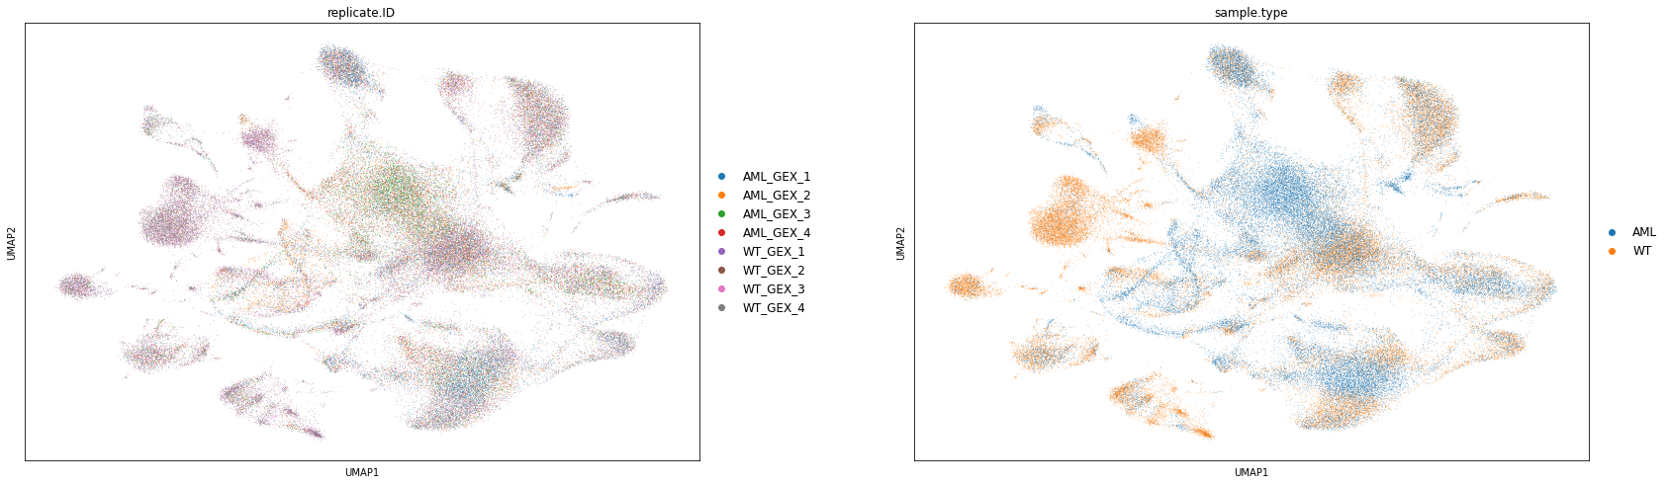
Dendritic Cells Clusters
Notes:
To construct the regulatory network, we focused on cluster 0.... Which is a , containing almost the same number of AML and WT cells.

Slide 10
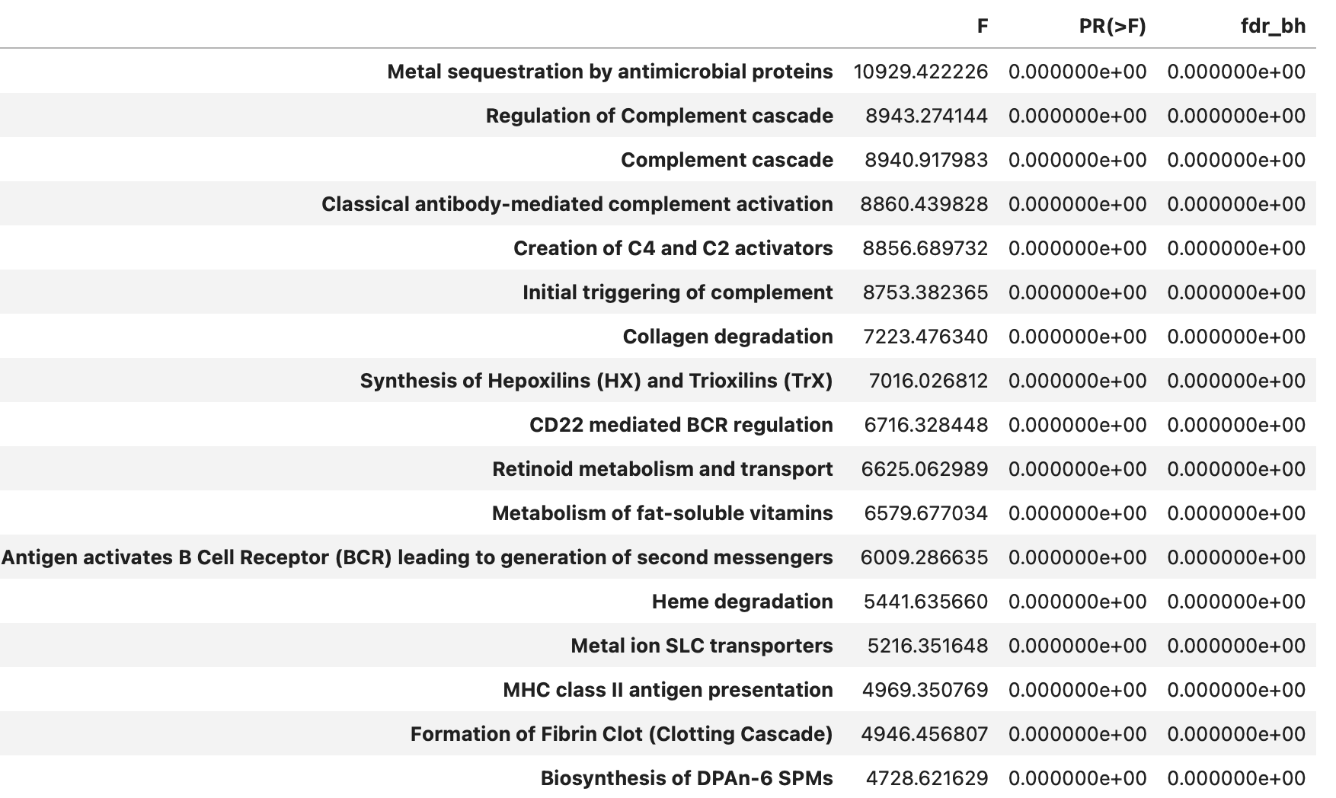
ANOVA for Pathways
Notes:
We did a AUCell analysis for Reactome pathways and then conducted ANOVA to find pathways which have significantly different activities among cell clusters. This table shows the top 17 pathways based on their F values. The majority of these pathways related to complement pathways and some related to cell cell interactions and small molecule pathways.
Vs. cell clusters

Slide 11
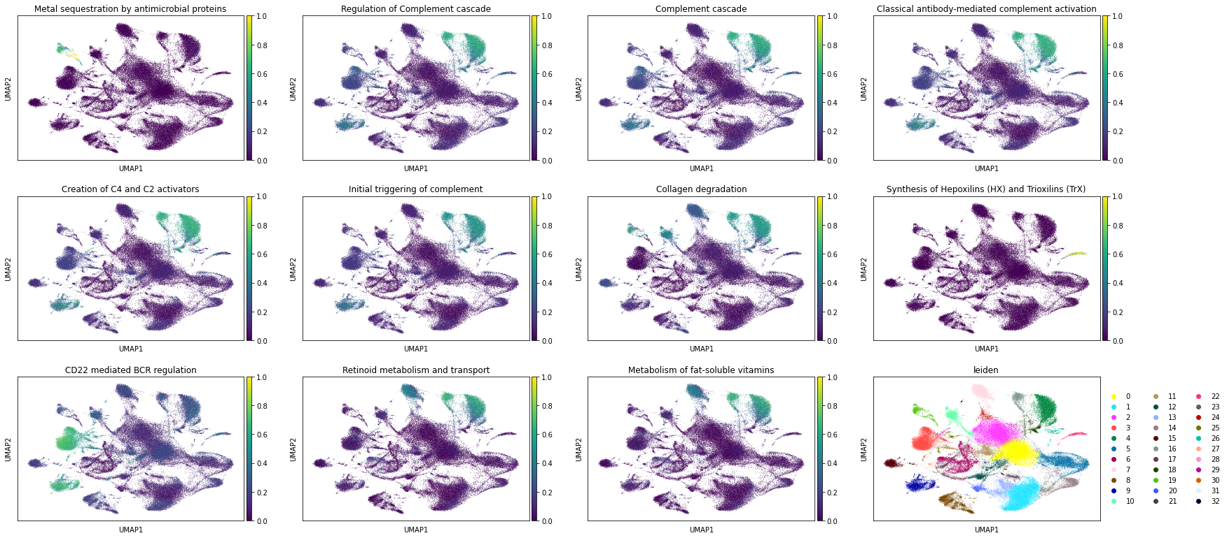
UMAP for Pathway Activities
Notes:
We can visualize individual pathways' activity in UMAP.

Slide 12
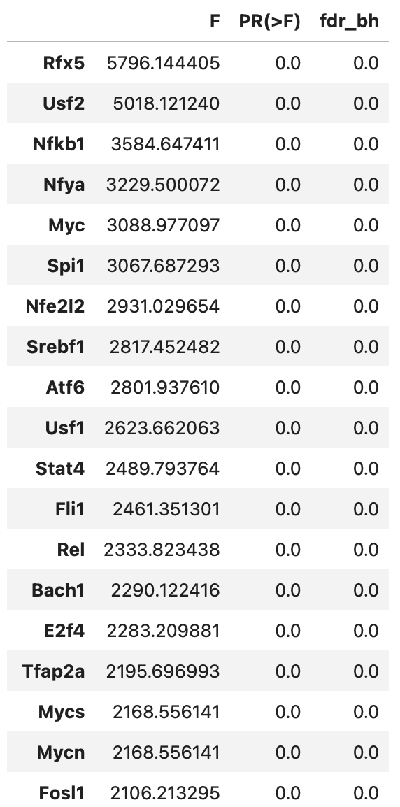
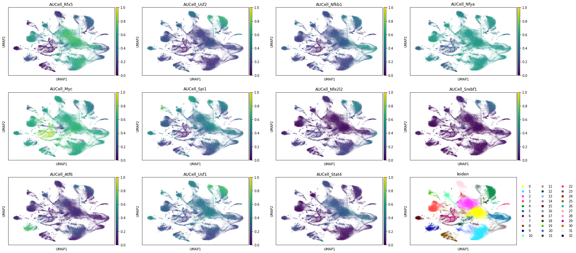
ANOVA for TFs
Notes:
We did the same AUCell analysis for TFs. This is a list of top TFs based on the F score from ANOVA. UMAP for TF AUCell scores.
Note: This is not gene expression counts of TFs. They are AUCell-based TF activity scores and are supposed to be more reliable to measure TF's activity then expression counts as explained before.

Slide 13
Dendritic Cells Cluster 0
AML: 5342
WT: 6115
Cell type: DC (dendritic cells)
Notes:
To construct the regulatory network, we focused on cluster 0.... Which is a , containing almost the same number of AML and WT cells.

Slide 14
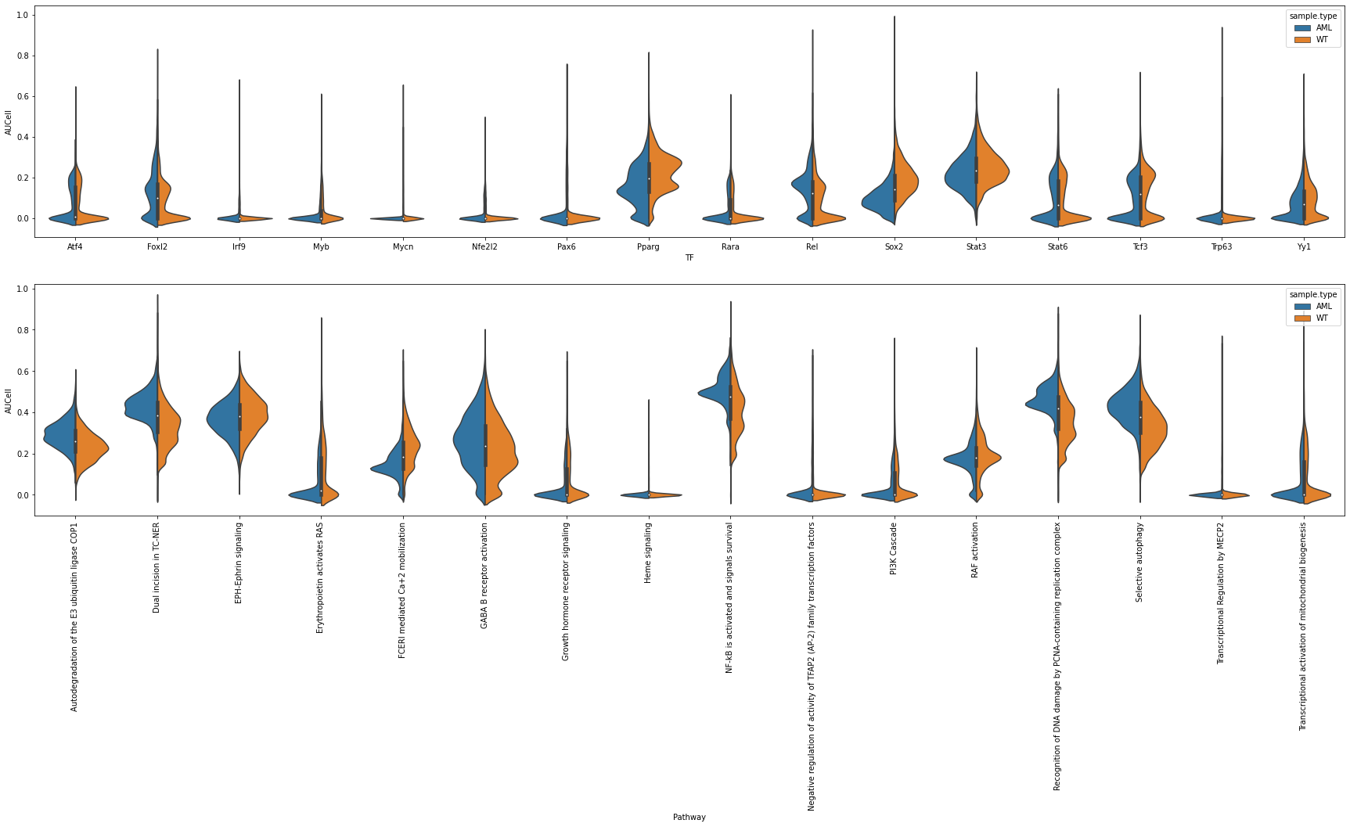
Distributions of Activities in DC Cluster 0
Notes:
Randomly sampled 16 TFs and 16 pathways from cluster 0: Quite complicated distribution.

Slide 15
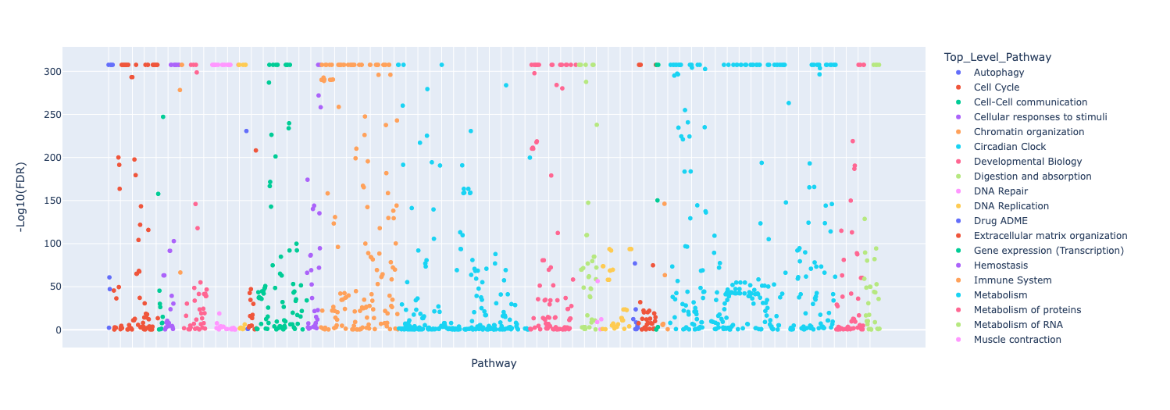
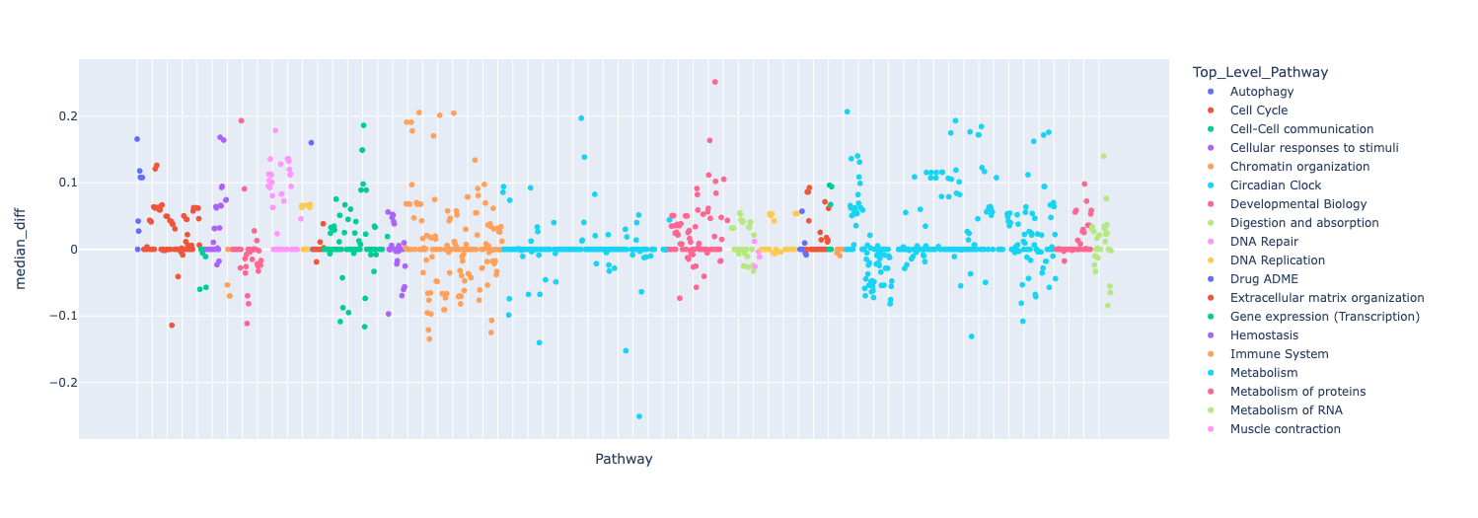
Differential Pathway Activity Analysis
Notes:
We did a differential pathway activity analysis and plot all differential analysis results into these two scatter plots..

Slide 16
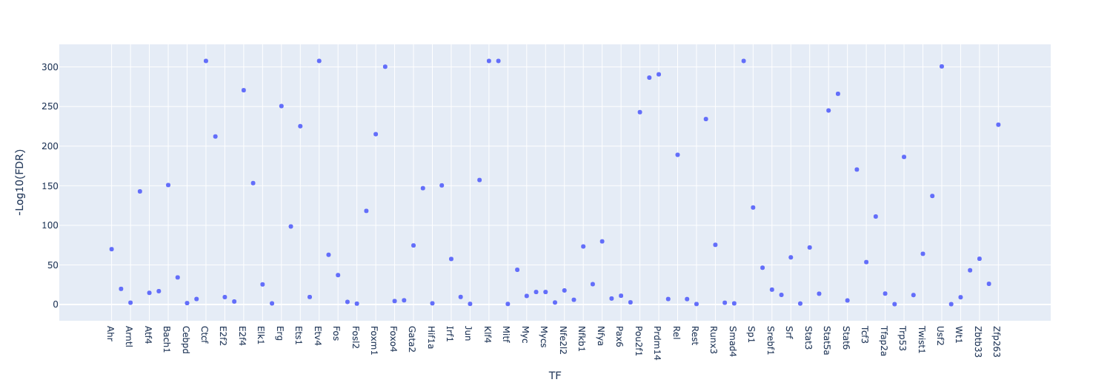
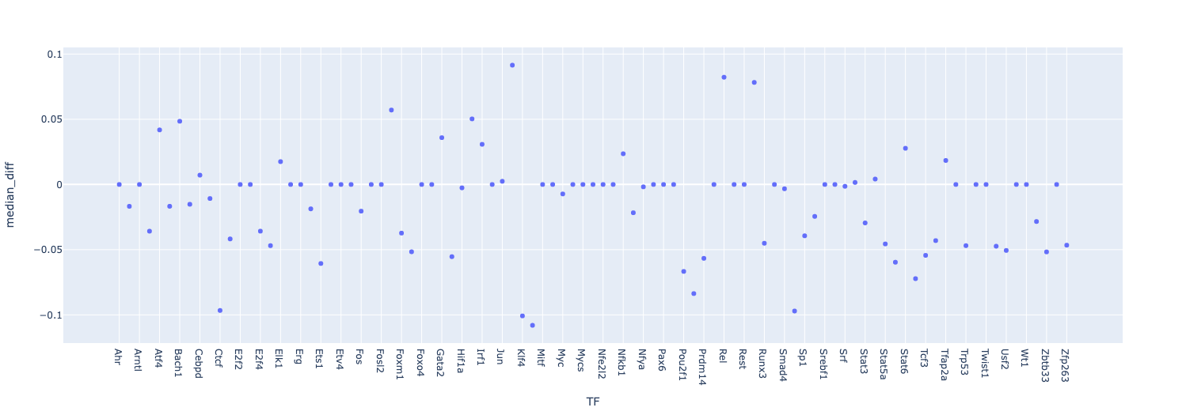
Differential TF Activity Analysis
Notes:
The same two plots for TFs subject to analysis. Because of the cutoff used, we only got about 50 TFs. Some more investigation is needed to improve this.

Slide 17
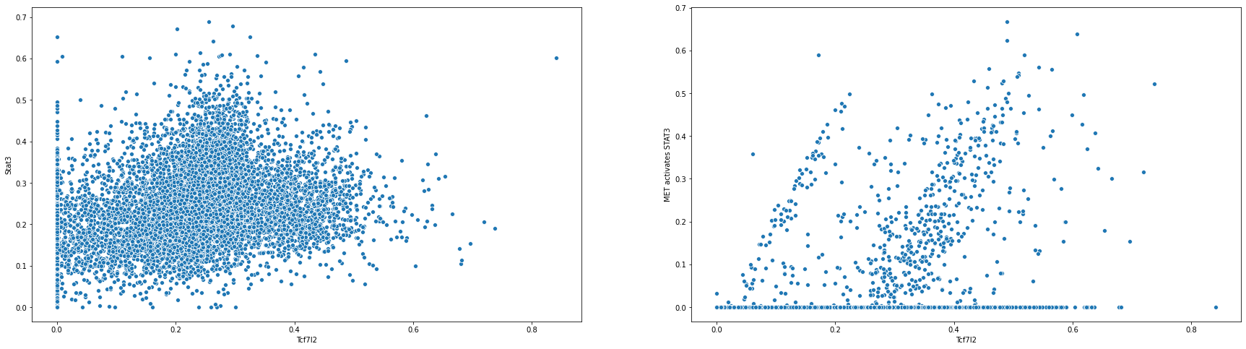
Correlation Examples
Spearman Correlation: 0.31 (p-value = 1.88E-257)
Spearman Correlation: 0.21 (p-value = 9.89E-110)
Notes:
Correlation analysis between pathway and TF show multiple significant relationships. For example the first is the plot between Stat3 and Tcf7l2,.

Slide 18
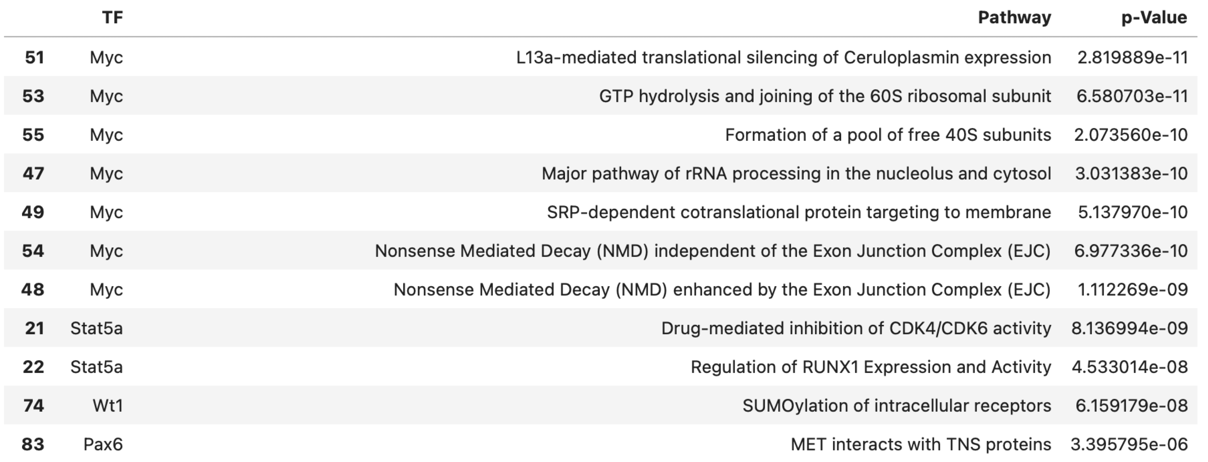
TF -> Pathway Interactions
GLM (Generalized linear model) for modeling correlations:
Pathway vs All Significant TFs
Direct interactions: Significantly overlapped between TF targets and pathway gene sets (pvalue cutoff 0.01)
Notes:
To better model correlations between pathways and TFs, we used GLM. The analysis is for individual pathways vs all significant TFs. Based on significant correlations for pathways and TFs, we did an overlap analysis between pathway genes and TF targets using hypergeom test and p-value < 0.01 as direct interactions from TFs to pathways. We may choose undirect interactions too if needed.
GLM: Python statsmodel using default settings. Needs to be improved.
p-value used: 0.01

Slide 19
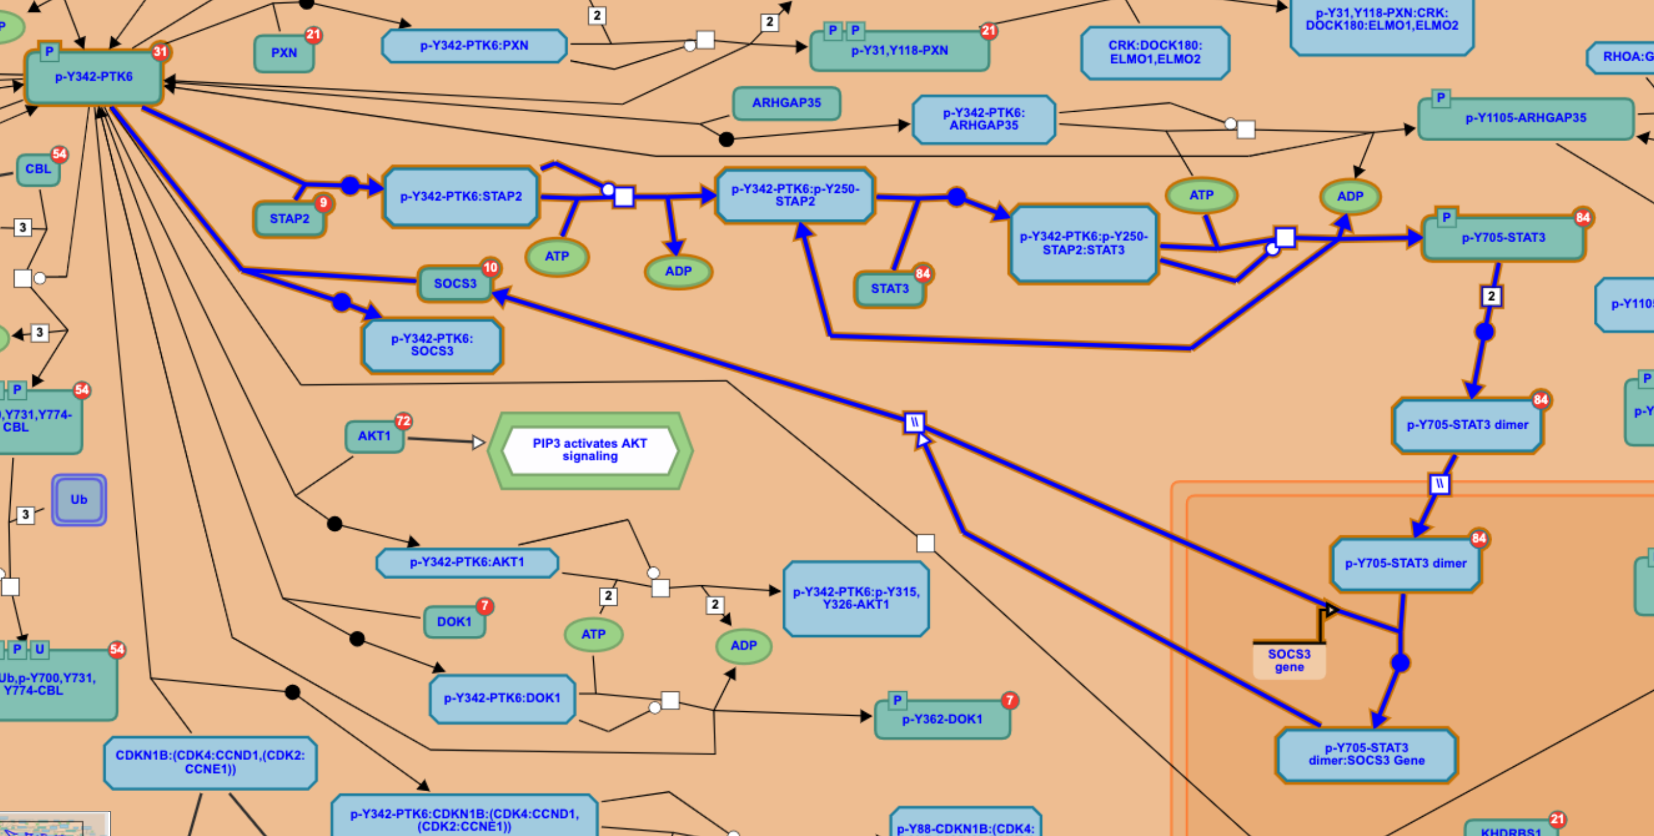
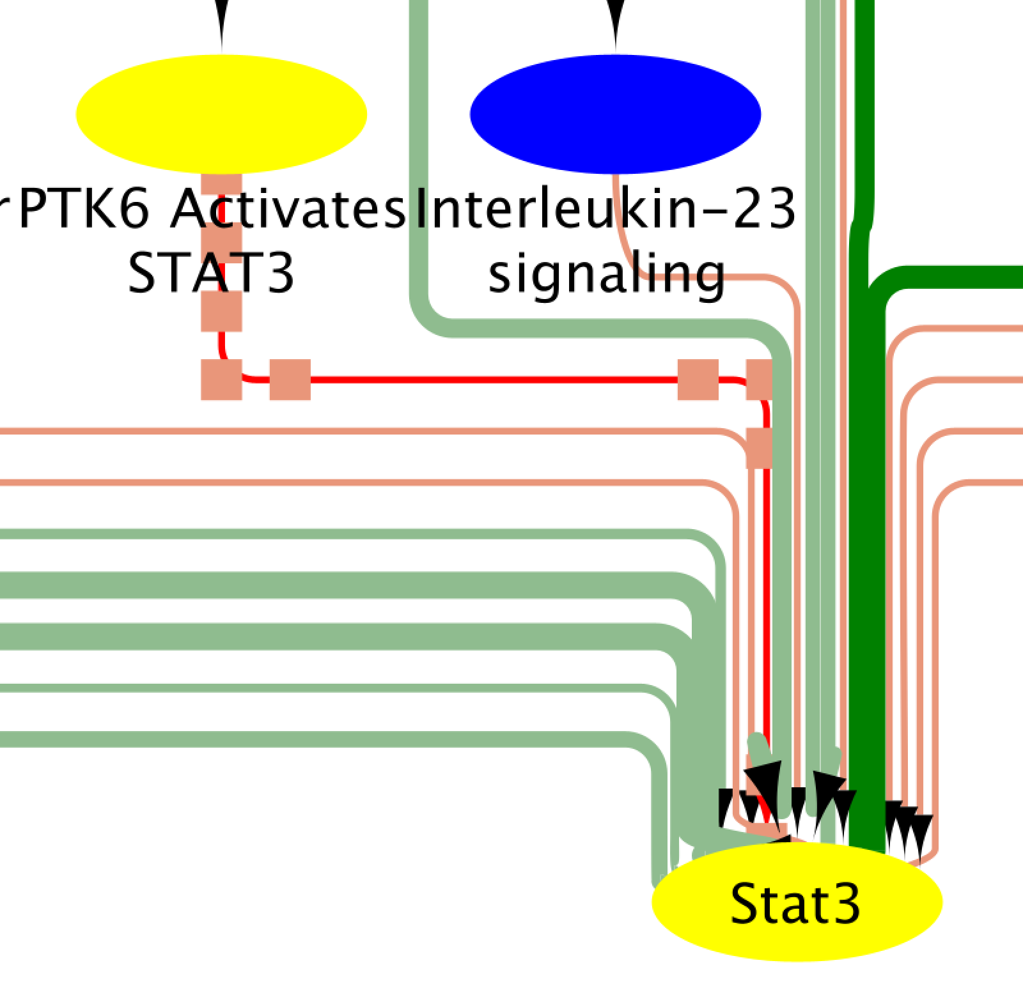
Pathway -> TF Annotation in Reactome
https://reactome.org/PathwayBrowser/#/R-HSA-8848021&SEL=R-HSA-8849474&PATH=R-HSA-162582,R-HSA-9006927
Notes:
In Reactome, we have also annotated regulation of TF inside pathways. Our regulatory network also includes this type of annotation by creating directed interaction from pathways to TF. For example, ... A pathway called ...,
Note: The annotation actually present a way to negatively regulates Stat3 TF activity. This step needs to be improved.

Slide 20
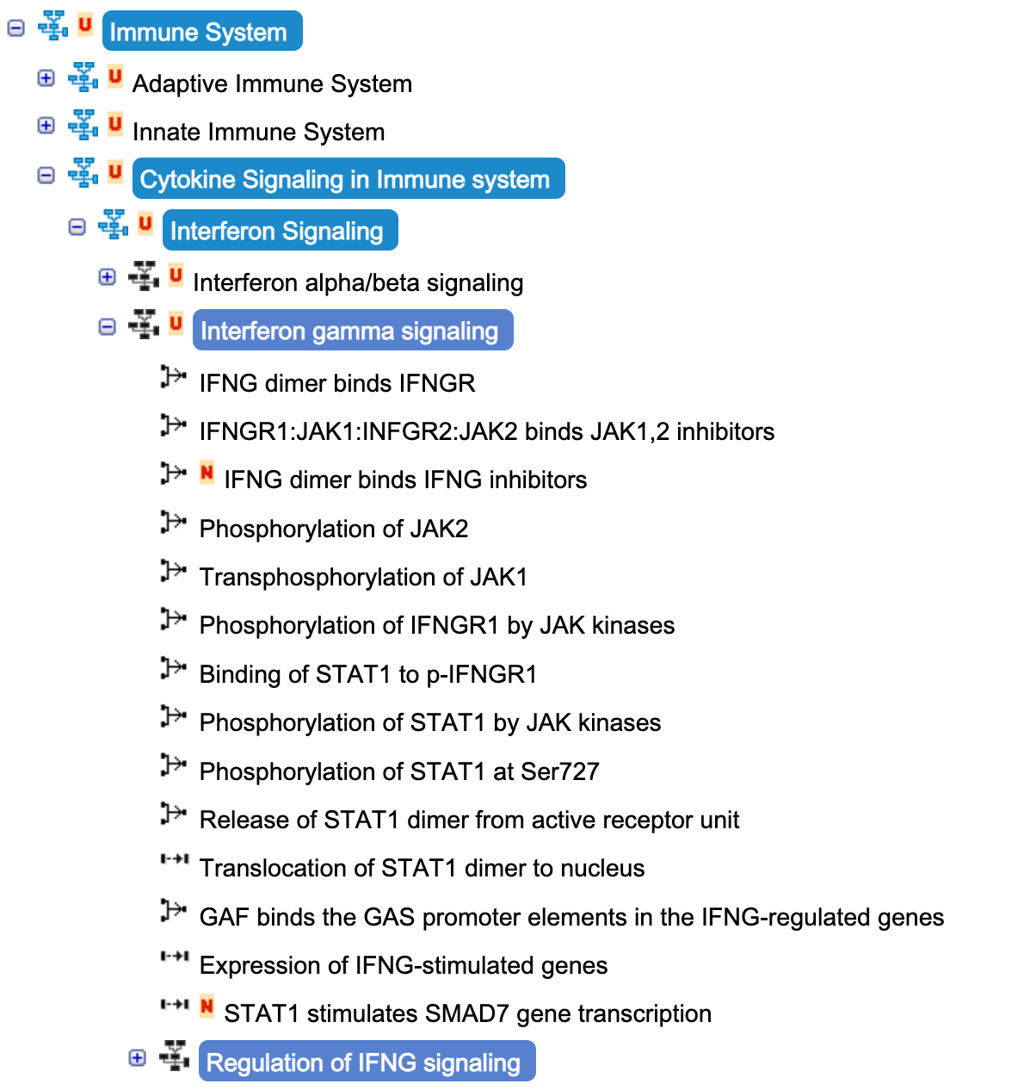
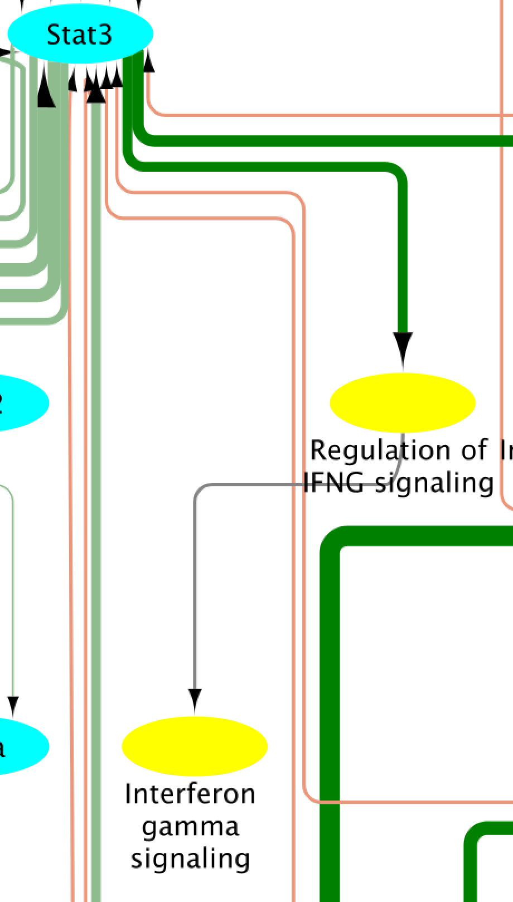
Pathway/Pathway Relationships
Notes:
To include pathway hierarchical relationships into our network, we use annotation in Reactome. For example, two pathways, …., have

Slide 21
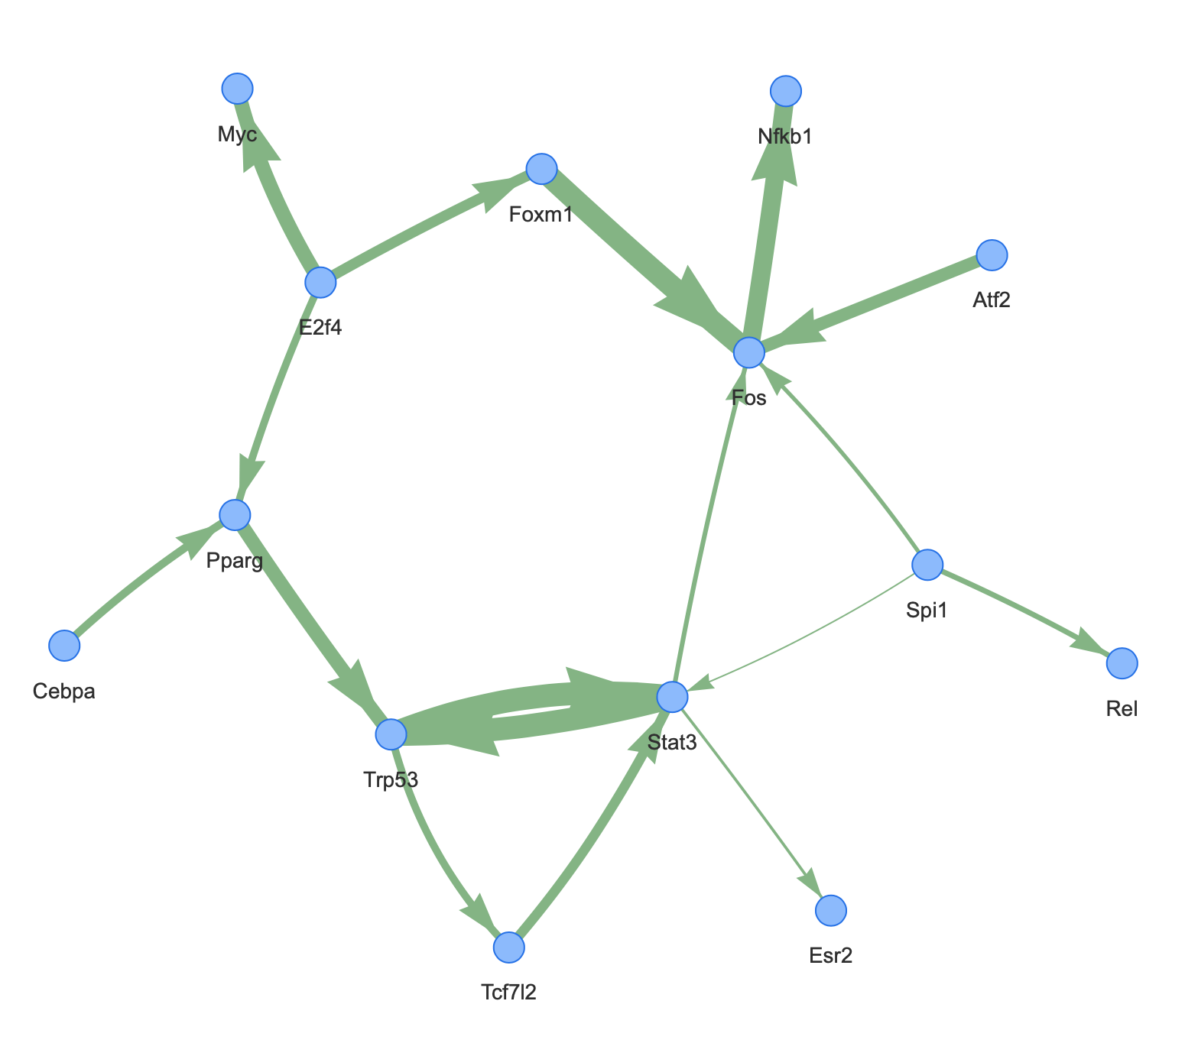
TF/TF Interactions
Correlations
Spearman correlation: cutoff > 0.25 (scaled based on GLM’s maximum value to comparison)
Direct interactions
E.g Tcf7l2 -> Stat3: Stat3 is a target of Tcf7l2
Indirect interactions are not considered
Notes:
For TF/TF interactions, we did another correlation analysis using Spearman correlation with cutoff > 0.25 and then check if the second TF is a target of the first TF, if true, we select the interaction as direct TF/TF interactions. Based on this, we got a network among TFs.

Slide 22
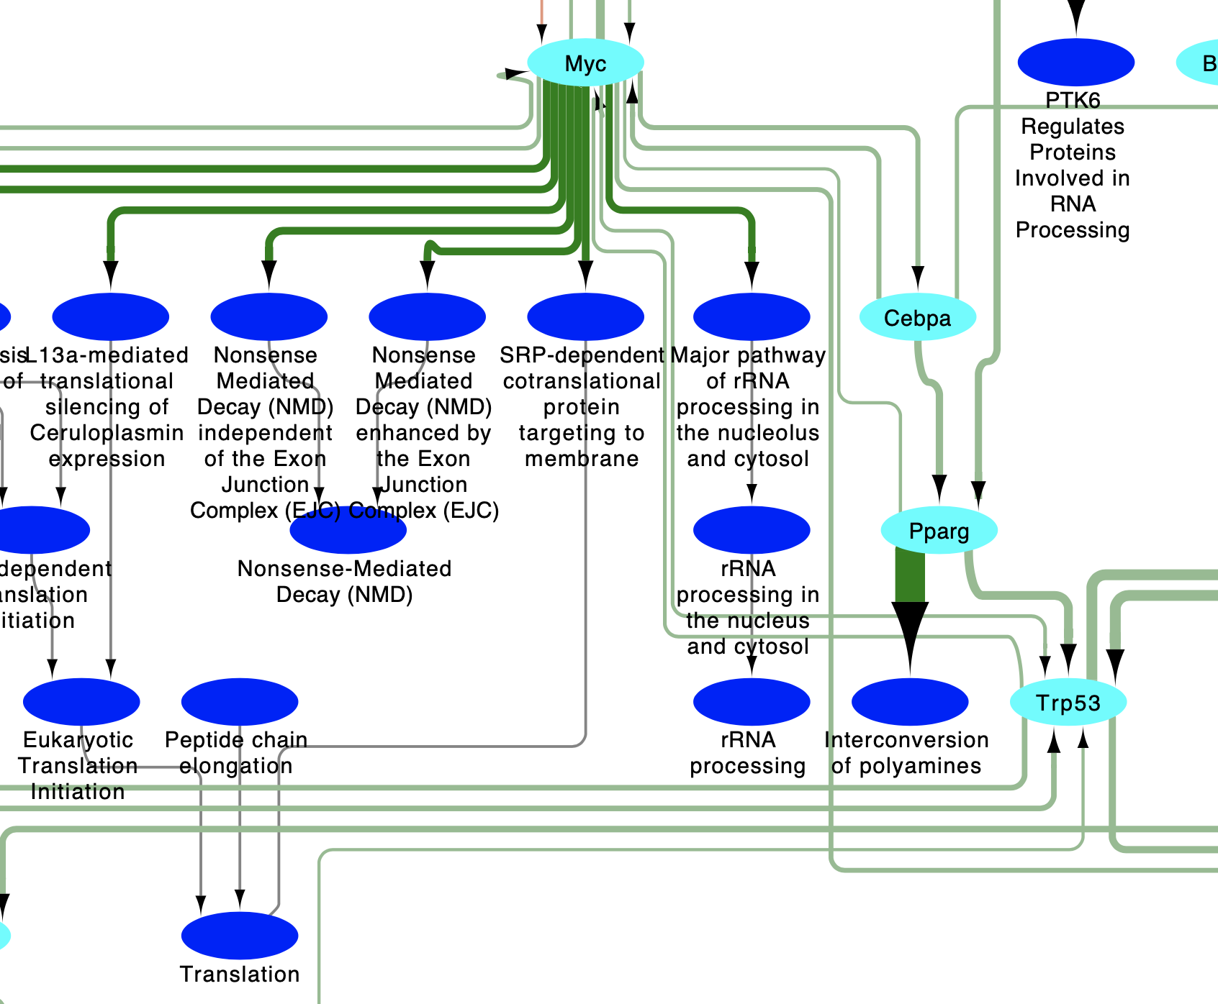
Regulatory Network of TFs and Pathways
Legends:
TF that has significant differential activity between AML and WT cells
TF activates TF (e.g. Cebpa activates Pparg)*
Source pathway is a sub-pathway oftarget pathway (e.g. “STAT3 nuclear events downstream of ALK signaling” is a sub-pathway of ”Signaling by ALK”)
Pathway that has significant differential activity between AML and WT cells
TF inhibits TF (e.g. E2f4 inhibits Bach1)*
*: The thickness of the edge indicates the strength of the correlation between the two node objects
**: The TF is annotated in a pathway. But the actual mechanism (e.g. activated, inhibited, or used in other reactions) has not exploited yet. But regardless the activity of the TF should be regulated via this pathway.
TF activates pathway (e.g. Jund activates “RUNX3 regulates CDKN1A transcription”)*
Pathway regulates TF (e.g. “PTK6 Activates STAT3” regulates Stat3**)
Notes:
By integrating all these interactions together into a single network, we construct a regulatory network for AML mouse DC cluster 0 for this scRNA-seq dataset.. We loaded this network into ReactomeFIViz. As you can see here:..

Slide 23
Regulatory Network of TFs and Pathways
Node color showing median difference between AML and WT cells. Negative (blue, left) means WT has higher activities while positive (red, right) means AML higher.
-0.25
0.25
Legends:
TF that has significant differential activity between AML and WT cells
TF activates TF (e.g. Cebpa activates Pparg)*
Source pathway is a sub-pathway of target pathway (e.g. “STAT3 nuclear events downstream of ALK signaling” is a sub-pathway of ”Signaling by ALK”)
Pathway that has significant differential activity between AML and WT cells
TF inhibits TF (e.g. E2f4 inhibits Bach1)*
TF activates pathway (e.g. Jund activates “RUNX3 regulates CDKN1A transcription”)*
*: The thickness of the edge indicates the strength of the correlation between the two node objects
**: The TF is annotated in a pathway. But the actual mechanism (e.g. activated, inhibited, or used in other reactions) has not exploited yet. But regardless the activity of the TF should be regulated via this pathway.
Pathway regulates TF (e.g. “PTK6 Activates STAT3” regulates Stat3**)
Notes:
The network can be used to visualize some interesting results. For example, we can overlay median difference of pathway and TF activities as shown in this screenshot. Here blue for negative difference, meaning higher in WT and lower in AML, red for ...

Slide 24
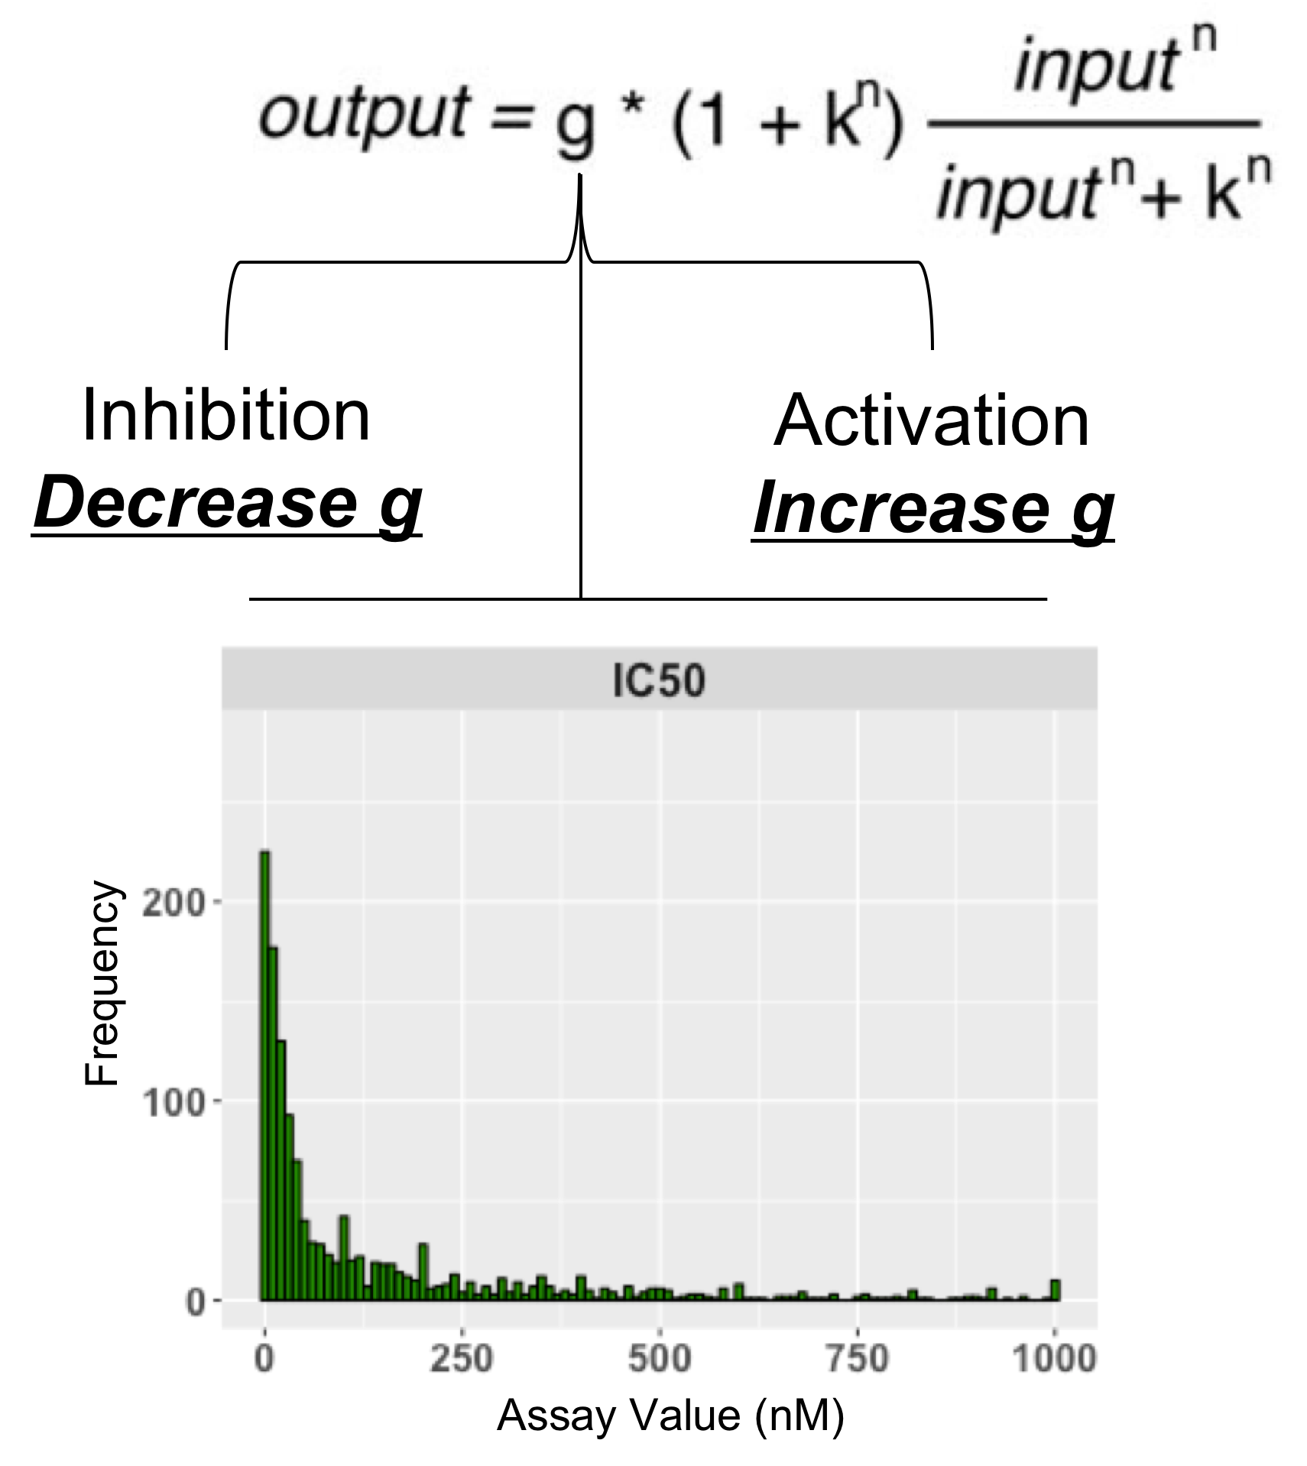
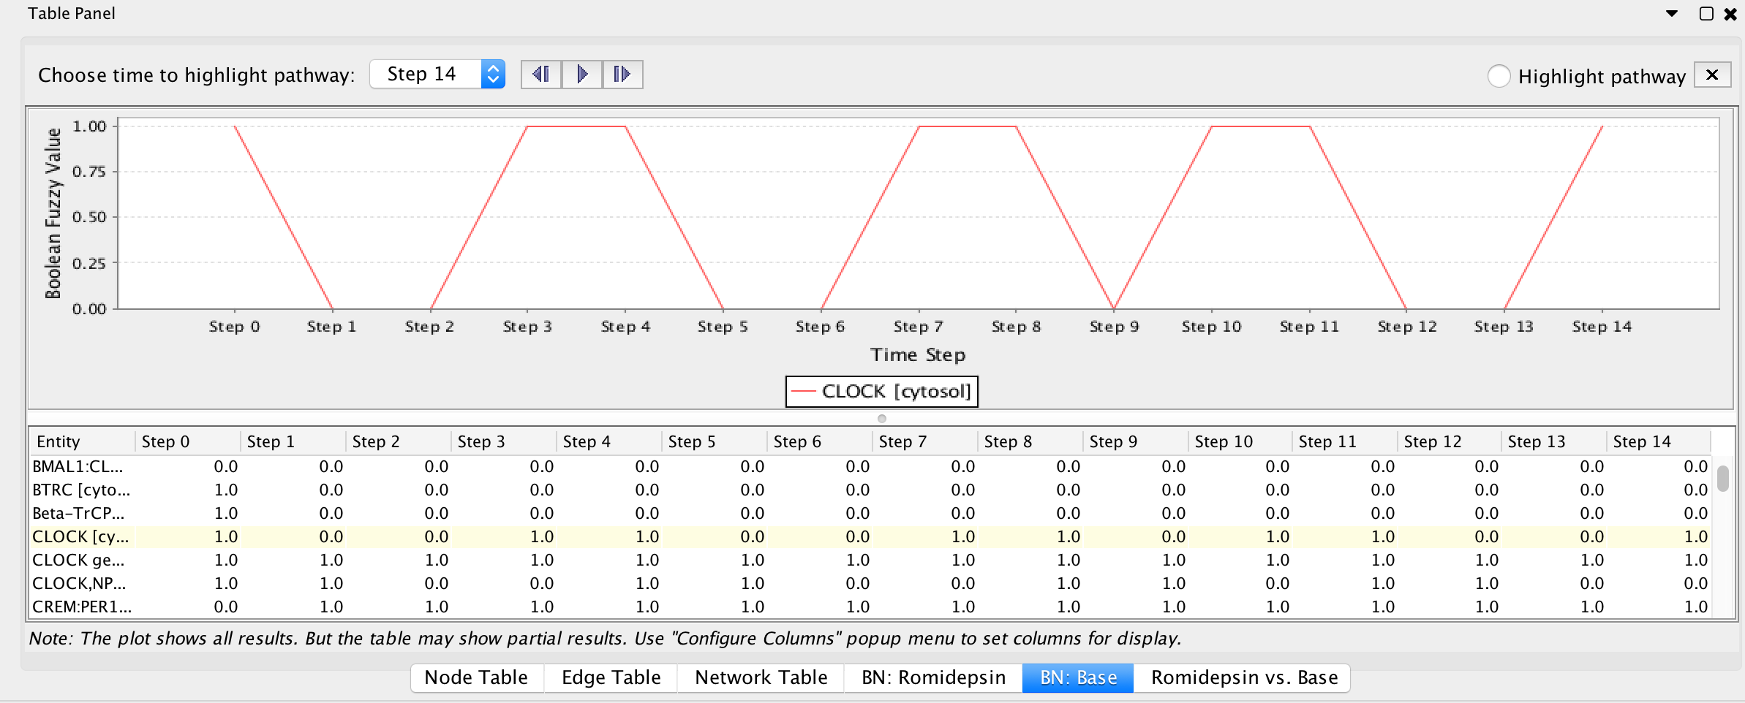
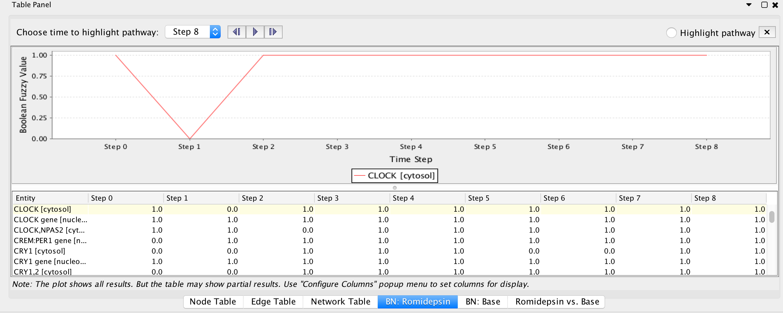
Fuzzy Logic Simulation
Before Romidepsin
After Romidepsin
Morris et al. 2011. PLoS Comput Biol. 7:e1001099
$$relative_impact_score= \frac{perturbation_AUC−reference_AUC}{perturbation_AUC+reference_AUC}$$
Notes:
Since in most cases, the data we got from biological studies are continuous variables, to better model this type of data, we can also extend the simple Boolean network into this so-called fuzzy logic model by assigning fuzzy values to variables in the model and then use some transfer function. For example, here is an example for a function called Hill function. With this model, we can simulate drug perturbation on pathway by inject drug/target interaction affinition into the equation. This is some result from modeling the clock gene's expression using Reactome's circadian clock pathway for drug romidepsin, which targets HDAC3 and NCOR1.
To measure the impact of drug application to the pathway activity, we run two simulation: the first assumes drug input = 0, i.e. without drug, the second assumes drug input = 1, i.e., with drug. Then we plot the dynamic behaviors and calculate the impact_socre based on area_under_curve (AUC) using this impact_score equation.
Based on experiments, this relative impact score can converge very quickly in cases we have tested. For example, here are examples for three entities impacted by application of drug romidepsin on Reactome’s circadian clock pathway. In this pathway, romidepsin targets HDAC3 and NCOR1.
Targets of romidepsin in this pathway: HDAC3 and NCOR1

Slide 25
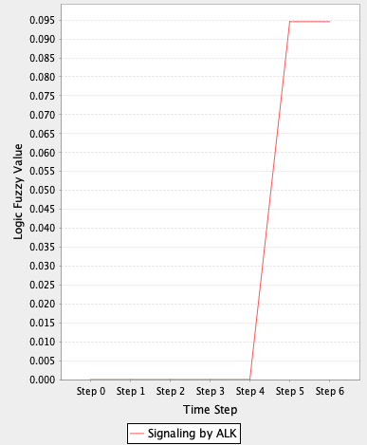
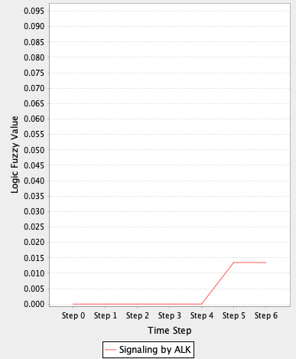
Example of Simulation Results
default parameters
Relative impact: -0.75
Tcf7l2 inhibited at 50%
Blucher et al. F1000Res.
2019. PMID: 31372215
Notes:
To better know the behavior of this regulatory network, we converted this network into a Boolean network automatically inside ReactomeFIViz for mathematical modeling and simulation. By doing this, we could simulate the effect of inhibition of pathway or TF on the network's behavior. For example,
D.a: Activity of “Signaling by ALK” under default parameters, b: Activity of “Signaling by ALK” with Tcf7l2 inhibited at 50%.

Slide 26
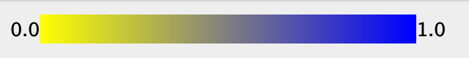
Example of Simulation Results
relative impact
Simulation results at time step 6 with default parameters
Notes:
The impact scores of each TF and pathway in the network can be visualizated in ReactomeFIViz directly by highlighting with a color scheme.

Slide 27
Validation of Networks and Simulation Results
Search for published literature
Experimental validation:
Collaboration with OHSU wet lab group
Genetic and biochemical experiments
…
Notes:
We plan to validate both our network and the simulation results. To validate some of our network components, we will search for published literature we are routinely done for Reactome annotation. We are also working with OHSU wet labs and see if we can design some … We submitted an abstract to …

Slide 28
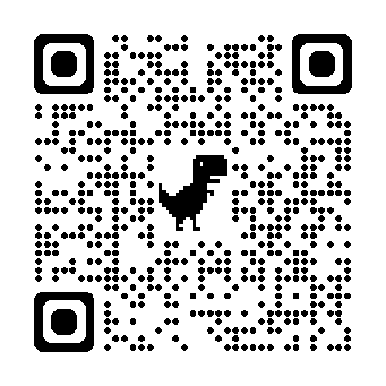
Software Resources
Reactome pathway analysis:
https://reactome.org/PathwayBrowser/#TOOL=AT
ReactomeFIViz:
https://reactome.org/userguide/reactome-fiviz
Python packages:
scpy4reactome: https://github.com/reactome-fi/fi_sc_analysis/tree/master/python
sc_regulatory_network: https://github.com/reactome-fi/sc_regulatory_network
Notes:
To develop this work flow, we have enhanced …

Slide 29
Acknowledgements
Oregon Health & Science University (OHSU)
Anupriya Agarwal
Evan Lind
Patrick Flynn
Patrick Conley
Shannon McWeeney
Christopher Klock
Melissa Wong
Ashley Anderson
Nicole Giske
Supported by NIH and KCI
NIH grants U01CA239069, U41HG003751, U24HG012198 and U54CA224019
Knight Cancer Institute Pilot Grant
The Reactome Project Team
https://reactome.org/about/team

